Slide 1
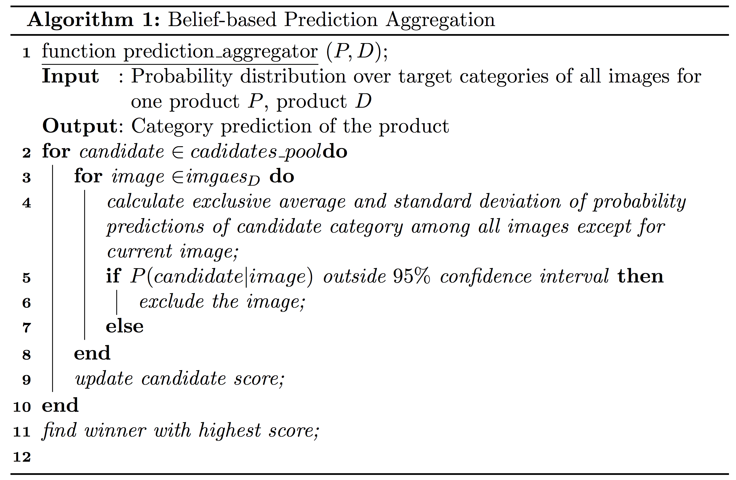




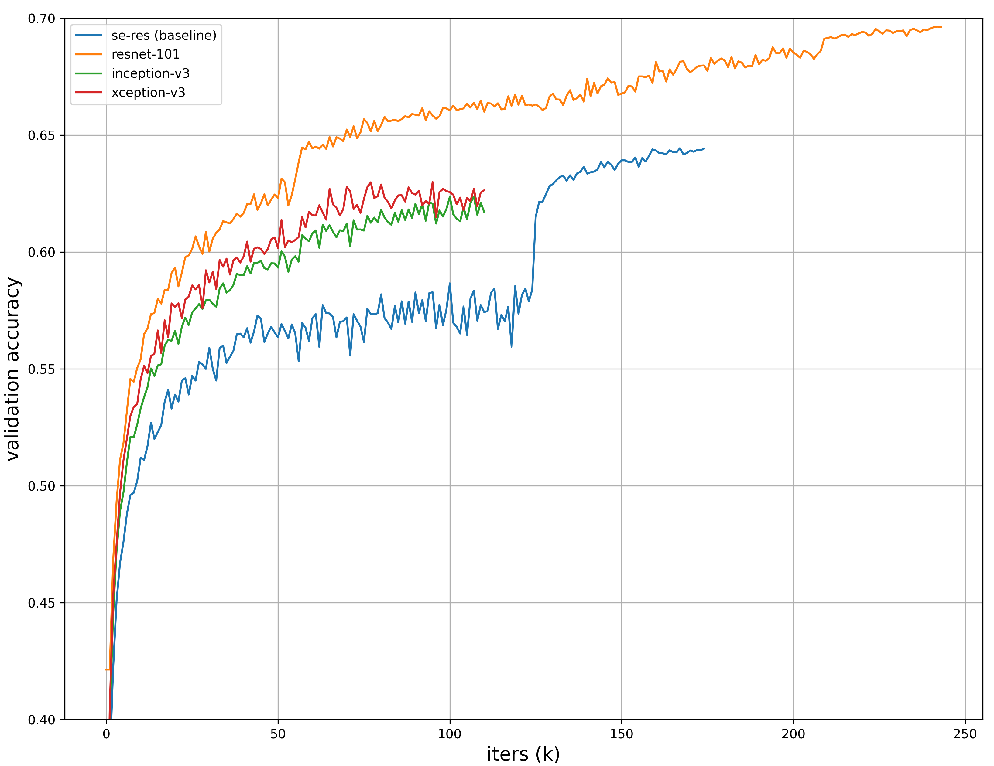
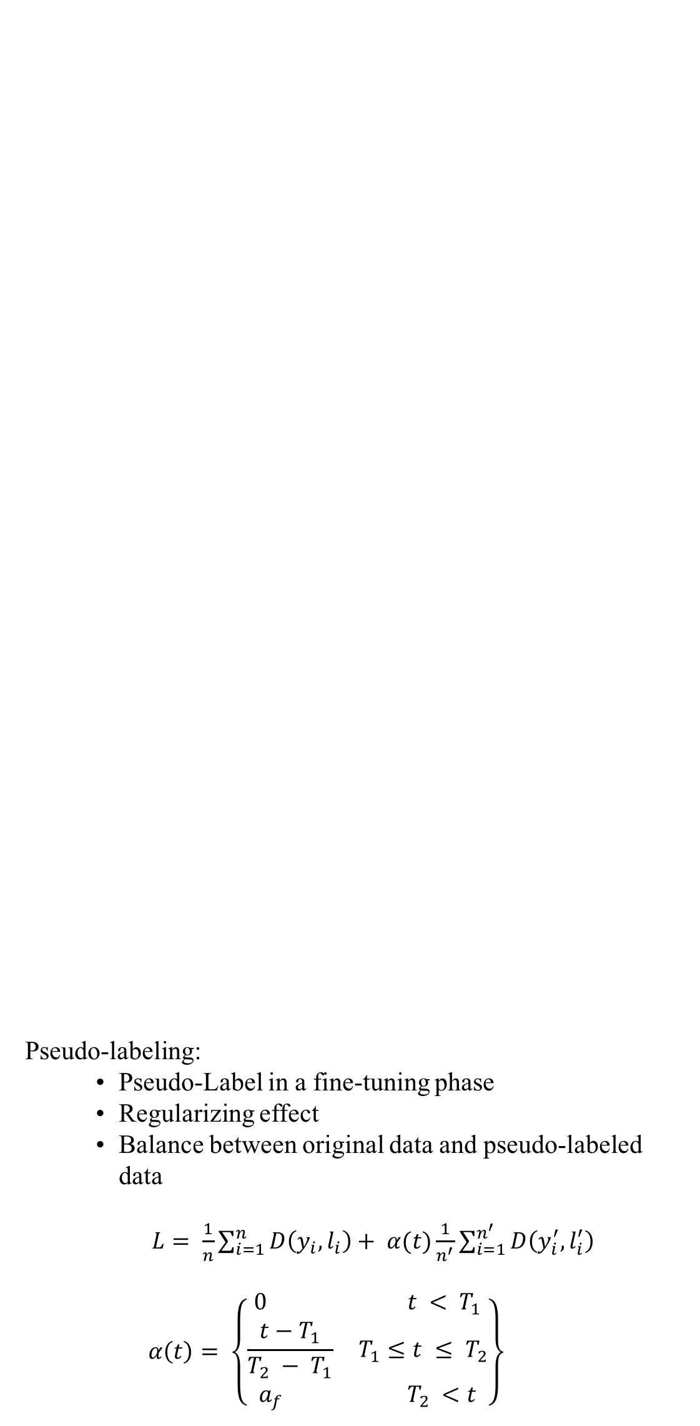
Deep Neural Network Ensembles for Extreme Classification
Yichen PAN, Yuxuan SUN
Carnegie Mellon University
Overview
Problem:
Extreme classification on Cdiscount’s dataset
Much noisy data
Image-wise classification => product-wise classification
Goal:
Classify each product (with 1-4 images) into 5,270 anonymous categories
Pseudo-labeling:
Pseudo-Label in a fine-tuning phase
Regularizing effect
Balance between original data and pseudo-labeled data
$L= \frac{1}{n}\sum_{i=1}^{n}{D\left(y_{i}, l_{i}\right)+ α(t)\frac{1}{n^{′}}\sum_{i=1}^{n^{′}}{D\left(y_{i}^{′}, l_{i}^{′}\right)}}$
$$α\left(t\right)= \left\{\begin{aligned}0 t < T_{1} \\ \frac{t−T_{1}}{T_{2} − T_{1}} T_{1}≤t ≤ T_{2} \\ a_{f} T_{2} <t\end{aligned}\right\}$$
Experiments/Results
Based on Tesla K80 Accelerators with one GPU of12 GiB of memory
Resume on pre-trained models from Pytorch
Gradient accumulation
SGD with scheduled learning rate
Augmentation: random resize/flip/shift/crop/rotate
Batch size trick: increase the batch size rather than decay the learning rate
 | Validation Accuracy
Resnet-101-baseline | 0.638
Resnet-101-TTA (1-2) | 0.648
Ensemble(ResNet101+Inception+Xception)-TTA (1-1) | 0.653
 | Test Accuracy
Resnet-101-baseline | 0.683
Resnet-101-TTA (1-2) | 0.703
Resnet-101-Pseudo-Labeling | 0.712
 | Train | Validation | Test
Images | 12,118,359 | 252,934 | 3,095,080
Products | 6,924,452 | 147, 758 | 1,768,182
Experiments Results
 | Se-ResNet-50 (Baseline) | Inception | Xception | ResNet-101
Input Size | 160*160 crop from 180*180 | 180*180 | 180*180 | 160*160 crop from 180*180
Batch | 160*2 | 64*4 | 64*4 | 64*4
Time per epoch | 55.54h | 31h | 31h | 64h
Network Settings
Methodology:
Deep Ensembles:
Resnet:
Residual Learning
Identity Mapping by Shortcuts
Inception
Stack of Inception modules
Convolution factorization
Xception:
Depth-wise separable convolution layer
Residual connection
Test Time Augmentation (TTA):
Augmentation: random resize/flip/shift/crop/rotate
Prediction Aggregation:
Naïve: average of augmented predictions => vulnerable to noise
Robust: A Gaussian confidence interval based prediction aggregation algorithm:
Pipeline of the whole system
Comparison of Model Accuracy of Validation Set
Future Work
Implement affine transformations as layers in a network
Further fine-tune the models

